Slide 1

Temporal Constraints Networks
Foundations of Constraint Processing
CSCE421/821, Spring 2011
www.cse.unl.edu/~cse421
Berthe Y. Choueiry (Shu-we-ri)
Avery Hall, Room 360
choueiry@cse.unl.edu
Tel: +1(402)472-5444
Topic

Slide 2
Reading
Required
  Dechter’s book Chapter 12
Recommended
  Manolis Koubarakis, Temporal CSPs, Chapter 19 in the Handbook of CP. 2006
  R. Dechter, I. Meiri, and J. Pearl, Temporal constraint networks. AIJ, Vol. 49, pp. 61-95, 1991
  I. Meiri, Combining Qualitative and Quantitative Constraints in Temporal Reasoning, 1995
  Shapiro, Feldman, & Dechter, On the Complexity of Interval-based Constraint Networks, 1999
  L. Xu & B.Y. Choueiry, Improving Backtrack Search for Solving the TCSP, CP 2003, pp 754-768. 2003
  L. Xu & B.Y. Choueiry, A New Efficient Algorithm for Solving the Simple Temporal Problem, TIME 2003, pp 212--222
  B.Y. Choueiry & L. Xu, An Efficient Consistency Algorithm for the Temporal Constraint Satisfaction Problem, AI Comm. pp. 213-221
  Many more papers by A. Cesta, A. Oddi, P. van Beek, Golumbic & Shamir, M. Pollack, I. Tsamardinos, P. Morris, etc.
Acknowledgements: Chen Chao of Class of 2003, Xu Lin (MS 2003)
Topic

Slide 3
Outline
Background
Qualitative Temporal Networks
  Interval Algebra
  Point Algebra
Quantitative Temporal Networks
  Simple Temporal Problem (STP)
  Temporal CSP
Topic

Slide 4
Usefulness of Temporal Reasoning
Many application areas
  Planning, scheduling, robotics, plan recognition, verification..
Reasoning about time requires
  A mathematical representation of time
    Qualitative (before, after, not during)
    Quantitative (10 minutes before, ‘no less than 2 no more than 3 hours’, etc.)
  Design of algorithms. In CP, it is search & propagation
Approaches in AI
  Temporal Logics
  Temporal Networks (using CSPs)
Topic

Slide 5
Vocabulary for Temporal Reasoning in CSPs
Temporal objects
  Points, beginning and ending of some landmark events: BC/AD
  Intervals, time period during which events occur or propositions hold: during class, a.m., p.m.
Constraints: Qualitative & Quantitative
  Qualitative: Relation between intervals / time points
    Interval algebra: before, during, starts, etc.
    Point algebra: <, =, >
  Quantitative: duration of an event in a numerical fashion
    Intensional relations: x – y < 10
    Constraints of bounded differences: 5 < x – y < 10, (5,10)
Domain of variables: continuous intervals in R
Topic

Slide 6
Outline
Background
Qualitative Temporal Networks
  Interval Algebra
  Point Algebra
Quantitative Temporal Networks
  Simple Temporal Problem (STP)
  Temporal CSP
Topic

Slide 7
Interval Algebra (aka Allen Algebra) [Allen 83]
Relation | Symbol | Inverse | Illustration
X before Y | b | bi
X equal Y | =
X meets Y | m | mi
X overlaps Y | o | oi
X during Y | d | di
X starts Y | s | si
X finishes Y | f | fi
x
y
x
y
x
y
x
y
x
y
x
y
x
y
Topic

Slide 8
Interval Algebra: Qualitative TN
Variables
  An interval represent an event with some duration
Constraints
  Intervals I, J are related by a binary constraint
  The constraint is a subset of the 13 basic relations
    r = { b, m, o, s, d, f, bi, mi, oi, si, di, fi, = }
  Example: I {r₁,r₂,…,r_{k}} J ⇔ (I r₁ J) ∨ (I r₂ J) ∨ … ∨ (I r_{k} J)
  Enumerate atomic relations between two variables
  We are not interested in
    The domains of the variables
    Explicit relations between the domains of variables
Topic

Slide 9
Interval Algebra Constraint Network
See Definition 12.1, page 336
Variables: temporal intervals I and J
Domain: set of ordered pairs of real numbers
Constraints are subsets of the 13 relations
  How many distinct relations?
A solution is an assignment of a pair of numbers to each variable such that no constraint is violated
Topic

Slide 10
Interval Algebra: Example
Story:
John was not in the room when I touched the switch to turn on the light but John was in the room later when the light was on.
CSP model:
Variables:
Switch – the time of touching the switch
Light – the light was on
Room – the time that John was in the room
Constraints:
Switch overlaps or meets Light: S {o, m} L
Switch is before, meets, is met by or after Room: S {b, m, mi, bi} R
Light overlaps, starts or is during Room: L {o, s, d} R
Light
{o, m}
{o, s, d}
Switch
Room
{b, m, mi, a}
Topic

Slide 11
The Task: Get the Minimal Network
Light
Light
Constraint
Tightening
{o, m}
{o, s, d}
{o, m}
{o, s}
Switch
Room
Switch
Room
{b, m}
{b, m, mi, a}
A unique network equivalent to original network
All constraints are subsets of original constraints
Provides a more explicit representation
Useful in answering many types of queries
Topic

Slide 12

Path Consistency in Interval Algebra (1)
Intersection
Composition computed using Table 12.2 page 339
 | b | s | d | o | m
b | b | b | b o m d s | b | b
s | b | s | d | b o m | b
d | b | d | d | b o m d s | b
o | b | o | o d s | b o m | b
m | b | m | o d s | b | b
Topic

Slide 13
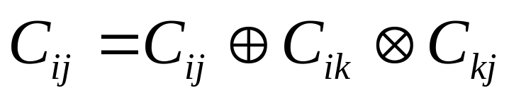
Path Consistency in Interval Algebra (2)
Intersection
Composition computed using Table 12.2 page 339
Qualitative Path Consistency (QPC-1 page 340)
  Tighten every pair of constraints using
  Until quiescence or inconsistency detected
Topic

Slide 14
Path Consistency in Interval Algebra (3)
QPC-1 is sometimes guaranteed to generate minimal network, but not always
  Because composing with d or o introduces disjunctions
Solution
  Use a backtracking scheme
  With path-consistency as a look-ahead schema
We cannot search on the variables
  The variables are the intervals
  So, the domains are continuous
  We build and search the dual of the IA network
Topic

Slide 15
BT Search with QPC as Lookahead
A minimal network
Search with QPC as look-ahead
Light
{o, m}
{o, s}
Light
Switch
{o, m}
{o, s, d}
{b, m, mi, a}
Switch
Room
Room
{b, m}
Dual graph representation
Use constraints as variables
Use common variables as edges
Topic

Slide 16
Outline
Background
Qualitative Temporal Networks
  Interval Algebra
  Point Algebra
Quantitative Temporal Networks
  Simple Temporal Problem (STP)
  Temporal CSP
Topic

Slide 17
Point Algebra (PA) [Vilain & Kautz 86]
Each variable represents a time point
Domain are real numbers
Constraints
  Express relative positions of 2 points
  Three basic relations: P < Q, P = Q, P > Q
  Constraints are PA elements, subset of {<, >, =}
  How many possible distinct relations?
Cheaper than IA:
  3 or 4-consistency guarantee minimal network
  Reasoning tasks are polynomial O(n³)
Topic

Slide 18
Point Algebra: Example
Story: Fred put the paper down and drank the last of his coffee
Modeling
  IA: Paper { s, d, f, = } Coffee
  PA: Paper: [x, y], Coffee:[z, t]
Constraints: x<y, z<t, x<t, x ≥ z, y ≤ t, y>z
Alert: Conversion from IA to PA not always possible
paper
paper
paper
paper
Coffee
Coffee
Coffee
Coffee
Topic

Slide 19
Path Consistency for Point Algebra
Algorithm is basically the same as for IA
Composition table
? means universal constraint
Minimal network
  Path consistency is sufficient for Convex PA (CPA) network
    Only have {<, ≤ , =, ≥ , >}
    Exclude ≠
  4 consistency is needed for general PA (including ≠)
 | < | = | >
< | < | < | ?
= | < | = | >
> | ? | > | >
Topic

Slide 20
Limitations of Point Algebra
In some cases, PA cannot fully express the constraints
Example: IA: Paper {b, a} Coffee
paper
coffee
y<z and t<x cannot
exist simultaneously
x y z t
coffee
paper
z t x y
Topic

Slide 21
Interval Algebra vs. Point Algebra
Determining consistency of a statement in IA is NP-hard
  Polynomial-time algorithm (Allen’s) sound but not complete
PA constraint propagation is sound & complete
  Time: O(n³) and space: O(n²)
  PA trades off expressiveness with tractability
  PA is a restricted form of IA
  PA can be used to identify classes of easy case of IA
Solution: Transform IA to PA
  Solve IA as PA and
  Translate back to IA, cost= O(n²)
Topic

Slide 22
Outline
Background
Qualitative Temporal Networks
  Interval Algebra
  Point Algebra
Quantitative Temporal Networks
  Simple Temporal Problem (STP)
  Temporal CSP
Topic

Slide 23
Quantitative Temporal Networks
Constraints express metrics, distances between time points
Express the duration of time
  Starting point x₁
  End point x₂
  Duration = x₂-x₁
Example
  John’s travel by car from home to work takes him 30 to 40 minutes
  or if he travels by bus, it takes him at least 60 minutes
  30 ≤ x₂ - x₁ ≤ 40 or 60 ≤ x₂ - x₁
Topic

Slide 24
Quantitative Network: Example
Simple Temporal Problem Example 12.7 (page 345)
  x0 =7:00am
  x1 John left home between 7:10 to 7:20
  x2 John arrive work in 30 to 40 minutes
  x3 Fred left home 10 to 20 minutes before x2
  x4 Fred arrive work between 8:00 to 8:10
  Fred travel from home to work in 20 to 30 minutes
x1
[30,40]
x2
[10,20]
x0
[10,20]
x3
x4
[20,30]
[60,70]
Topic

Slide 25
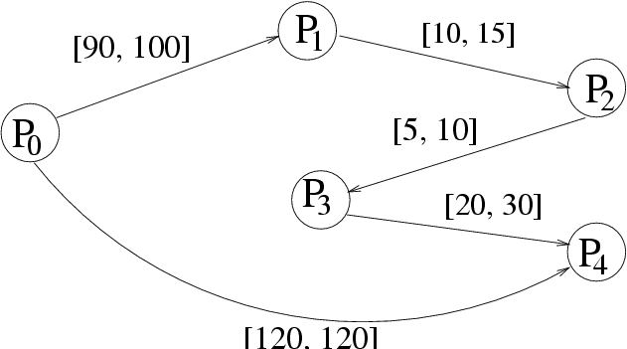
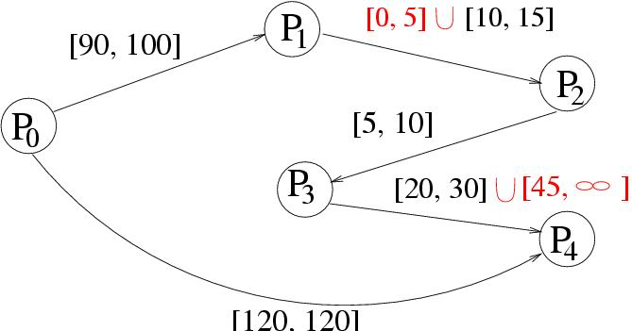
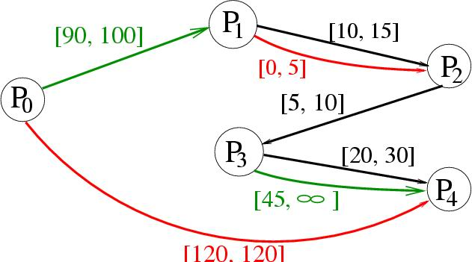
Temporal networks: STP ⊆ TCSP ⊆ DTP
Simple Temporal Problem (STP)
Each edge has a unique (convex) interval
Temporal CSP (TCSP)
Each edge has a disjunction of intervals
STP ⊆ TCSP [Dechter+, 91]
Disjunctive Temporal Problem (DTP)
Each constraint is a disjunction of edges
TCSP ⊆ DTP [Stergiou & Koubarakis, 00]
Topic

Slide 26
Outline
Background
Qualitative Temporal Networks
  Interval Algebra
  Point Algebra
Quantitative Temporal Networks
  Simple Temporal Problem (STP)
  Temporal CSP
Topic

Slide 27
Simple Temporal Network (STP)
A special class of temporal problems
Can be solved in polynomial time
An edge e_{ij}: i→j is labeled by a single interval [a_{ij}, b_{ij}]
Constraint (a_{ij} ≤ x_{j} - x_{i} ≤ b_{ij} ) expressed by
(x_{j} - x_{i} ≤ b_{ij} ) ∧ ( x_{i} - x_{j} ≤ -a_{ij} )
Example (x_{j} - x_{i} ≤ 20) ∧ ( x_{i} - x_{j} ≤ -10)
i
[10, 20]
j
Topic

Slide 28
Distance Graph of an STP
The STP is transformed into an all-pairs- shortest-paths problem on a distance graph
Each constraint is replaced by two edges: one + and one -
Constraint graph → directed cyclic graph
j
20
i
-10
Topic

Slide 29
Solving the Distance Graph of the STP
40
x1
x2
20
-30
x0
-10
20
-10
x3
50
x4
70
-60
-40
Run F-W all pairs shortest path (A special case of PC!)
If any pair of nodes has a negative cycle ⇒ inconsistency
If consistent after F-W ⇒ minimal & decomposable
Once d-graph formed, assembling a solution by checking against the previous labelling
Total time: F-W O(n³) + Assembling O(n²) = O(n³).
Topic

Slide 30
Algorithms for solving the STP
 | Graph | Complexity | Consistency | Minimality
F-W | Complete | Θ(n³) | Yes | Yes
DPC [Dechter+, 91] | Triangulated | O (nW*(d)²) very cheap | Yes | No
PPC [Bliek & S-H 99] | Triangulated | O (n³) Usually cheaper than F-W/PC | Yes | Yes
ΔSTP | Triangulated | Always cheaper than PPC | Yes | Yes
BF/incBF [Cesta & Oddi, 96] | Source point is added | O (en) | Yes | No
Consistency: Determine whether a solution exists
Minimal network: Make intervals as tight as possible
Topic

Slide 31
Partial Path Consistency (PPC)
Known features of PPC [Bliek & Sam-Haroud, 99]
  Applicable to general CSPs
  Triangulates the constraint graph
  In general, resulting network is not minimal
  For convex constraints, guarantees minimality
Adaptation of PPC to STP
  Constraints in STP are bounded difference, thus convex, PPC results in the minimal network
Topic

Slide 32
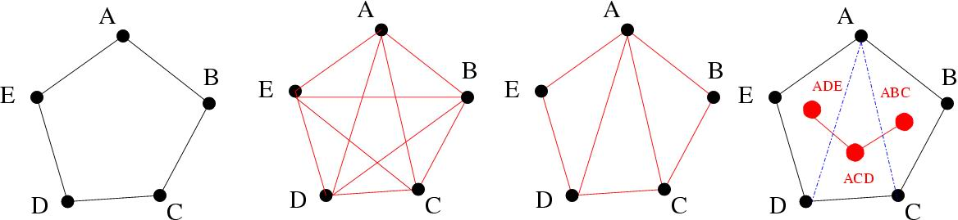
ΔSTP [Xu & Choueiry, 03]
Temporal graph
F-W
PPC
ΔSTP
ΔSTP is a refinement of PPC
  Simultaneously update all edges in a triangle
  Propagate updates through adjacent triangles
Topic

Slide 33
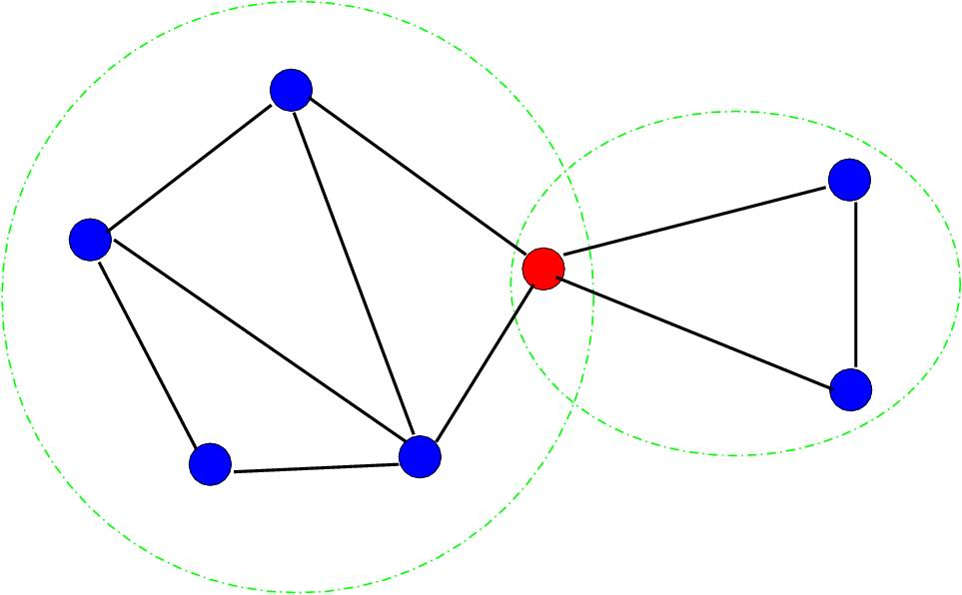
Advantages of ΔSTP
Cheaper than PPC and F-W
Guarantees the minimal network
Automatically decomposes the graph into its bi-connected components
  binds effort in size of largest
  component
  allows parallellization
Sweep through forth and back
  Observed empirically, 2003
  Explained by Nic Wilson @ 4C, 2005
  Proved by Neil Yorke-Smith @ SRI, 2006
Topic

Slide 34
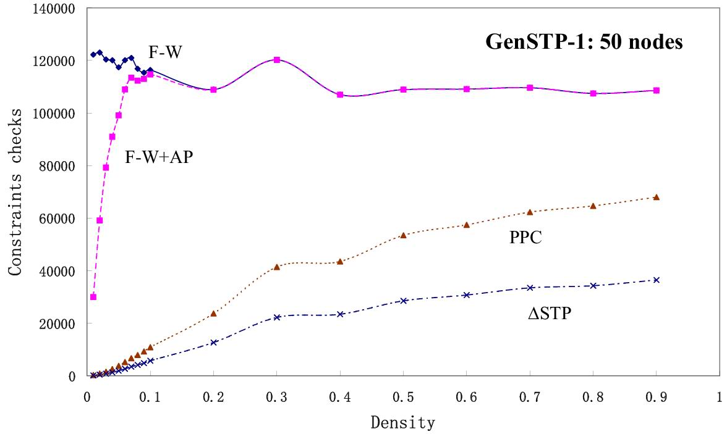
Finding the minimal STP
Topic

Slide 35
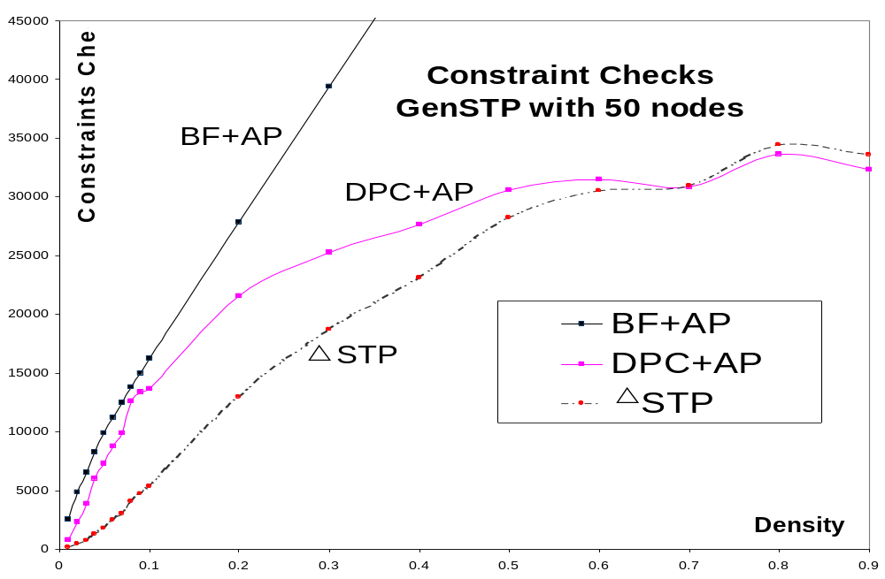
Determining consistency of the STP
Topic

Slide 36
Outline
Background
Qualitative Temporal Networks
  Interval Algebra
  Point Algebra
Quantitative Temporal Networks
  Simple Temporal Problem (STP)
  Temporal CSP
Topic

Slide 37
Temporal CSP (TCSP)
Variables
  A set of variables with continuous domain
  Each variable represents a time point
Constraints
  Each constraint is represented by a set of intervals { [1, 4], [6, 9], …, [20, 43] }
  Unary constraint: a₁ ≤ x_{i} ≤ b₁…
  Binary constraint: a₁ ≤ x_{j} - x_{i} ≤ b₁ …
Solutions
  A tuple x=<a₁, …, a_{n}> is a solution if x₁=a₁, x₂=a₂,…, x_{n}=a_{n} do not violate any constraints
[30,40]U
[60,oo]
[10,20]
x1
x2
[10,20]
x0
x3
[20,30] U [40,50]
x4
[60,70]
Topic

Slide 38
Temporal CSP
We are interested in the following questions
  Is it consistent?
    consistency problem)
  What are the possible time at which X_{i} could occur?
    Find the minimal domain problem)
  What are all possible relationship between X_{i} and X_{j}?
    Find the minimal constraint problem
[30,40]U [60,oo]
x2
[10,20]
x1
x0
[10,20]
x3
[20,30] U [40,50]
x4
[60,70]
Topic

Slide 39
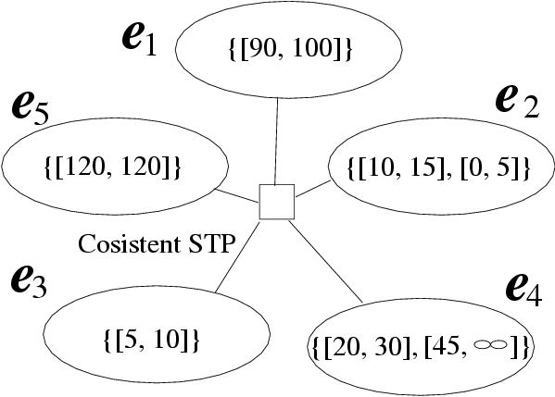
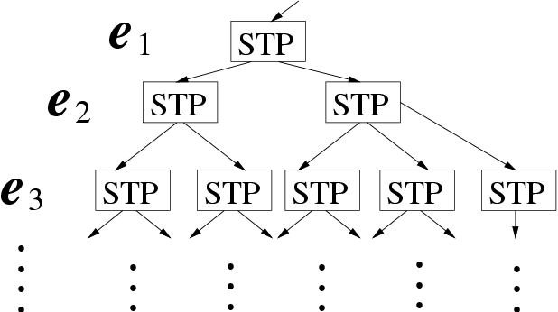
Solving the TCSP [Dechter+, 00]
Formulate TCSP as a meta-CSP
Find all the solutions to the meta-CSP
Use ΔSTP to solve the individual STPs efficiently
But first, can we use some constraint propagation on the meta-CSP?
Topic

Slide 40
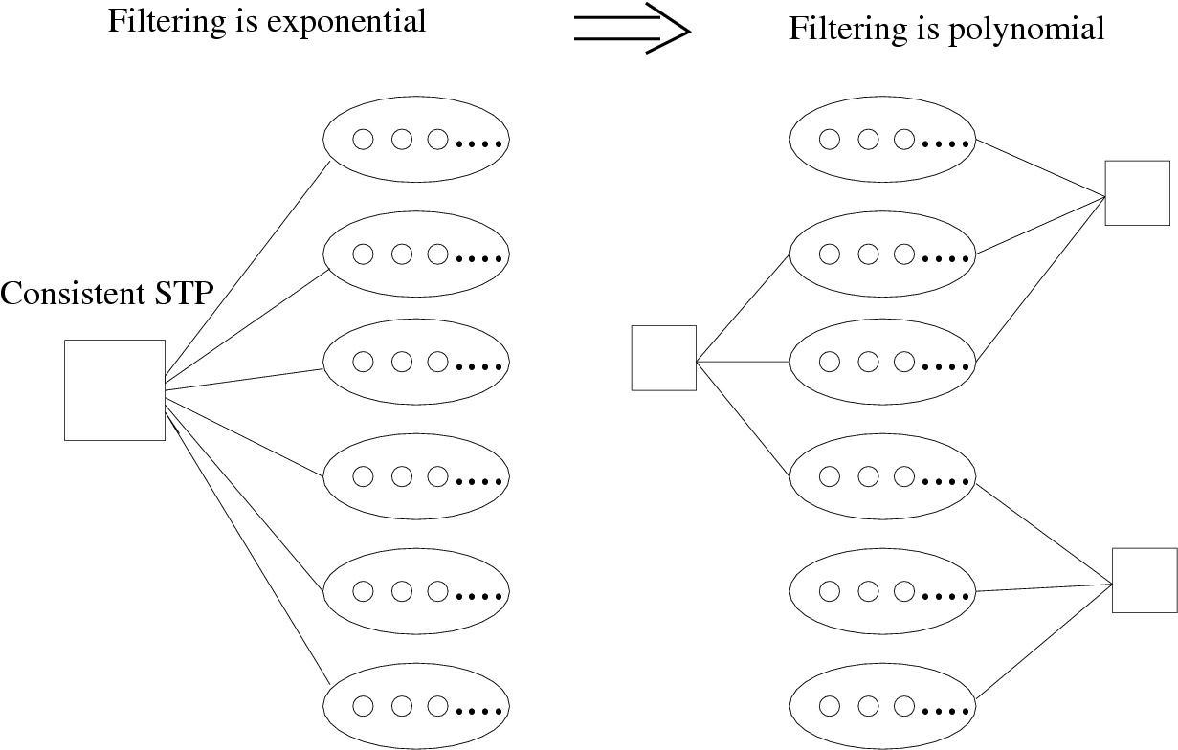
Preprocessing the TCSP
Arc consistency
  Single n-ary constraint
  GAC is NP-hard
ΔAC
  Works on existing triangles
  Poly # of poly constraints
Topic

Slide 41
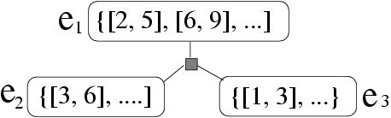
ΔAC filters domains of TCSP
ΔAC removes values that are not supported by the ternary constraint
For every interval in the domain of an edge, there must exist intervals in the domains of the 2 other edges such that the 3 intervals verify the triangle inequality rule
[1,3] in e₃ has no support in e₁ and e₂
ΔAC removes [1,3] from domain of e₃
Topic

Slide 42
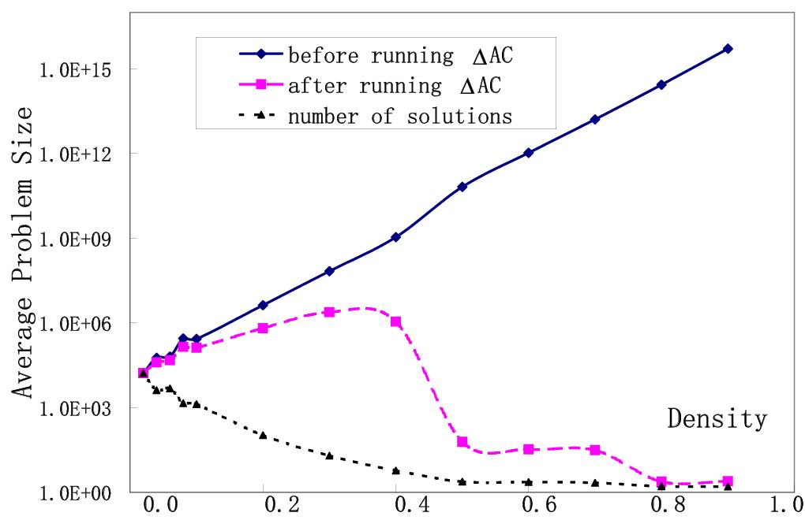
Reduction of meta-CSP’s size
Topic

Slide 43
Advantages of ΔAC
Powerful, especially for dense TCSPs
Sound and cheap O(n |E| k³)
It may be optimal
  Uses polynomial-size data-structures: Supports, Supported-by as in AC-4
Topic

Slide 44
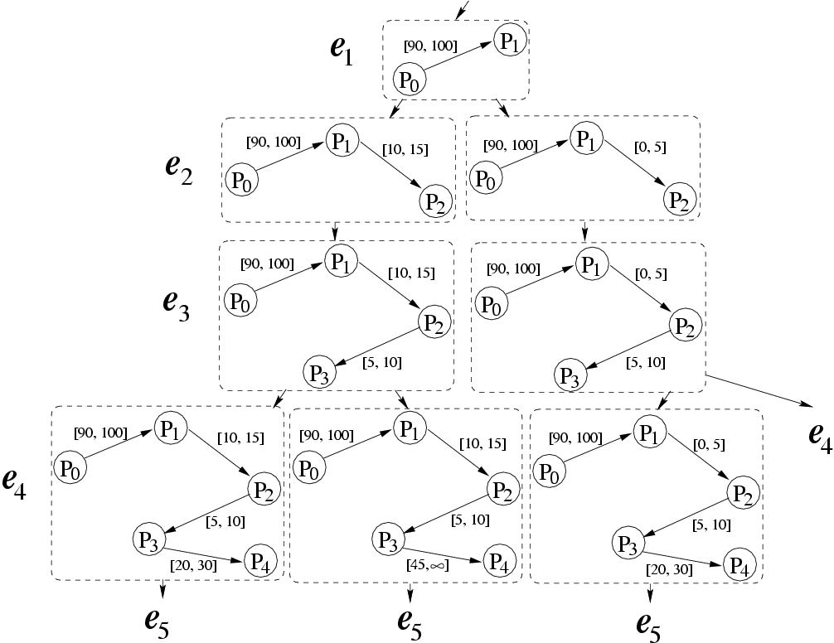
Improving search for the TCSP
New cycle check
Edge Ordering
Topic

Slide 45

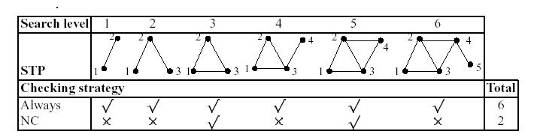
Checking new cycles: NewCyc
As a new edge is added at each step in search:
Check the formation of new cycles O(|E|)
Run ΔSTP only when a new cycle is formed
Topic

Slide 46
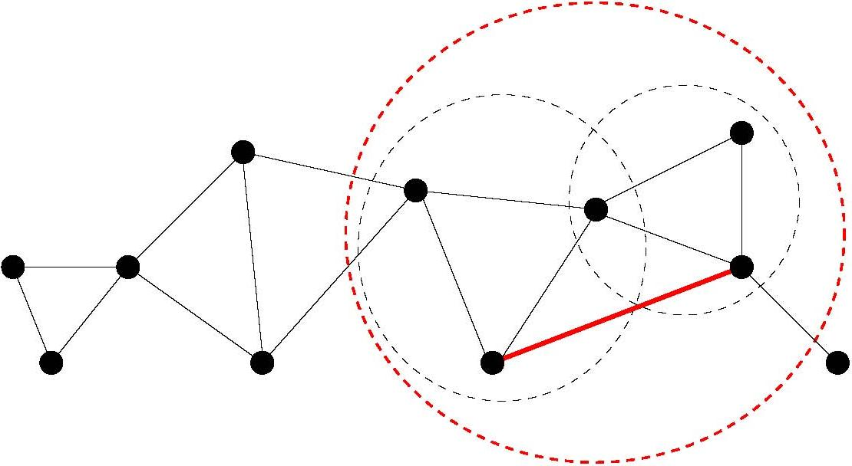
Advantages of NewCyc
Fewer calls to ΔSTP
Operations restricted to new bi-connected component
Does not affect # of nodes visited in search
Topic

Slide 47
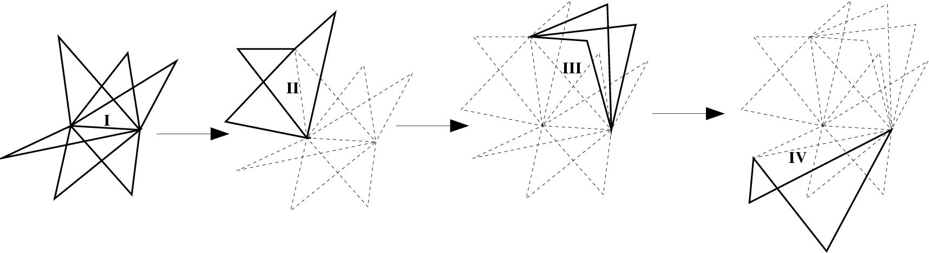
Edge ordering during search
Order edges using triangle adjacency
Priority list is a by product of triangulation
Topic

Slide 48
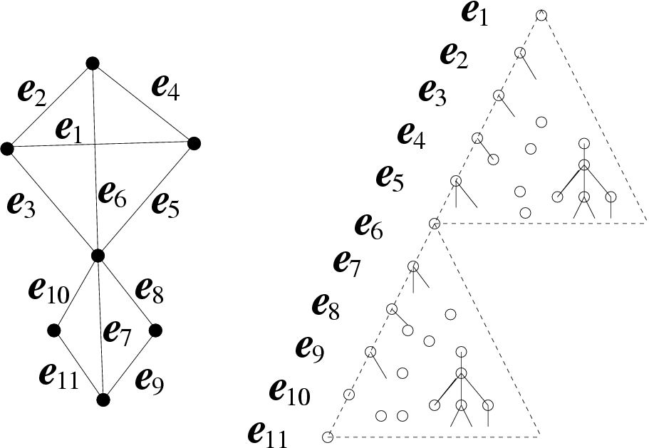
Advantages of EdgeOrd
Localized backtracking
Automatic decomposition of the constraint graph
→ no need for explicit detection of articulation points
Topic

Slide 49
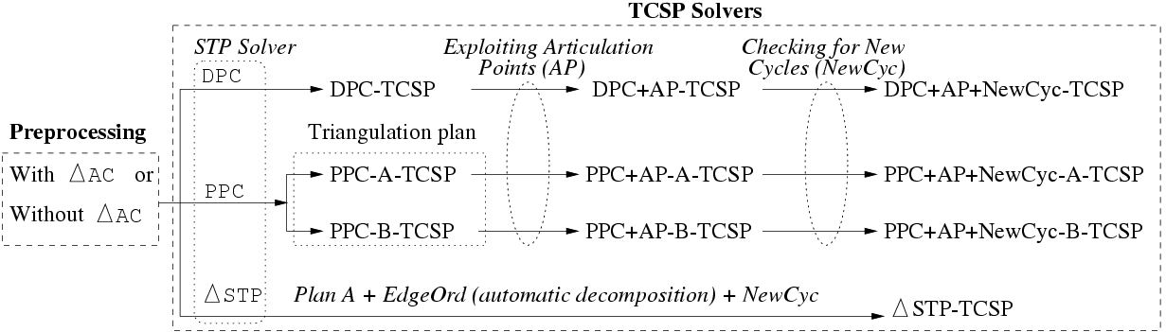
Experimental evaluations
New random generator for TCSPs
Guarantees 80% existence of a solution
Averages over 100 samples
Networks are not triangulated
Topic

Slide 50
Expected (direct) effects
Number of nodes visited (#NV)
  ΔAC reduces the size of TCSP
  EdgeOrd localizes BT
Consistency checking effort (#CC)
  AP, ΔSTP, NewCyc reduce number of consistency checking at each node
Topic

Slide 51
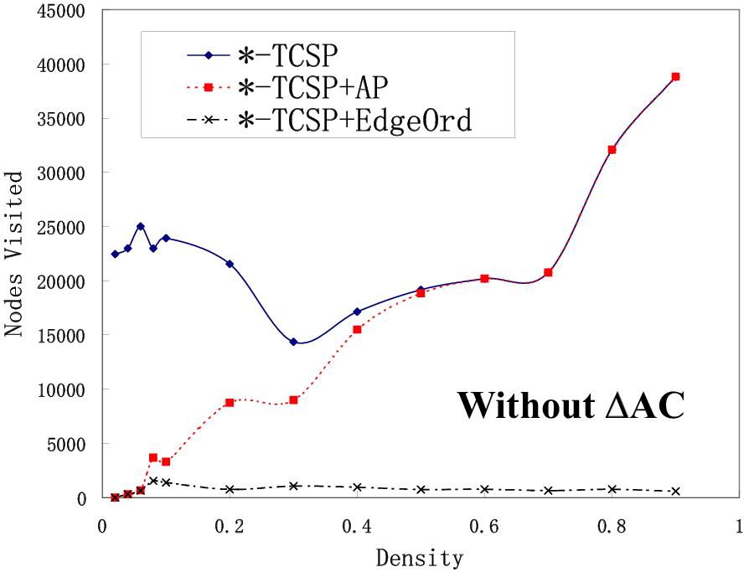
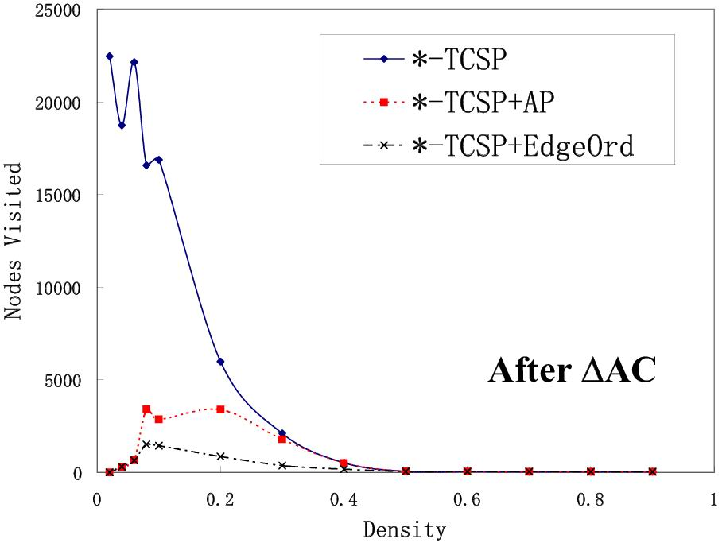
Effect of ΔAC on #nodes visited
Topic

Slide 52
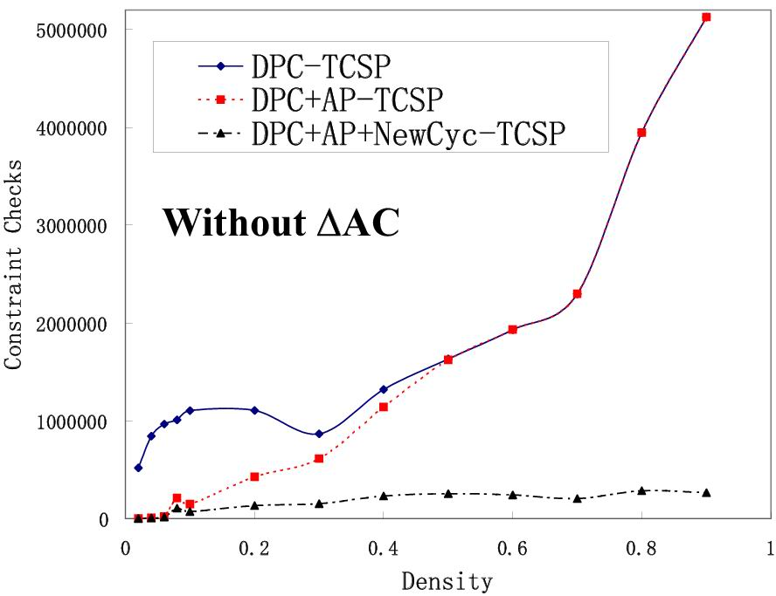
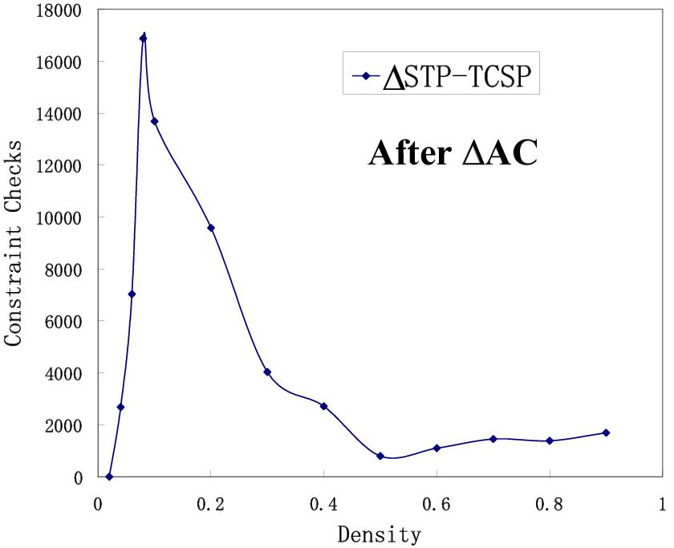
Cumulative Improvement
Before, after AP, after NewCyc,…
… and now (ΔAC, ΔSTP, NewCyc, EdgeOrd)
Max on y-axis 5.000.000
Max on y-axis 18.000, 2 orders of magnitude improvement
Topic

Slide 53
Testing IncBF [Cesta & Oddi, 96]
Algorithm | Performance Ranking
 | STP | TCSP
FW + AP DPC + AP BF + AP Δ STP | worse better OK best | worse OK - -
incBF + AP Δ STP + EdgeOrd + NewCyc incBF + AP + EdgeOrd + NewCyc | good - - | good better best
Topic

Slide 54
Summary
Background
Qualitative Temporal Networks
  Interval Algebra
  Point Algebra
Quantitative Temporal Networks
  Simple Temporal Problem (STP)
  Temporal CSP
  How about DTP?
    Introduced by Stergiou & Koubarakis
    Researched & used by Pollack & team
Topic

